Slide 2
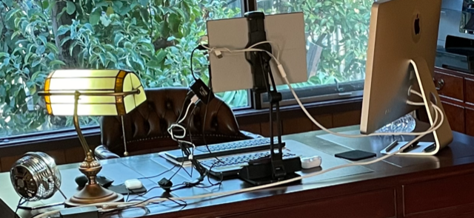

Slide 3
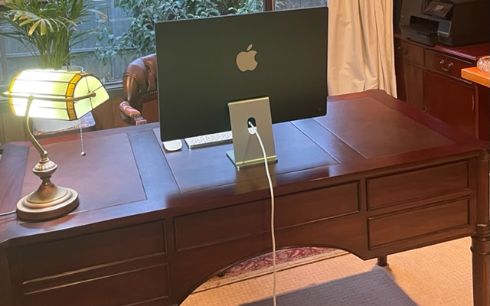

Slide 5
Problem Identification
1. What is the situation?
2. What are the problems?
3. What is the priority problem?
4. What are the possible causes?
5. What is the most likely cause?
6. What specific corrective action needs to be taken?

Slide 6
SCENARIO - Problem Identification
1. What is the situation? 5% conversion rate of quote to job
2. What are the problems? Delays in getting quotes to customers due to volume. Cashflow. 50% say they can’t afford it once they see the quote.
3. What is the priority problem?
4. What are the possible causes?
5. What is the most likely cause?
6. What specific corrective action needs to be taken?

Slide 8
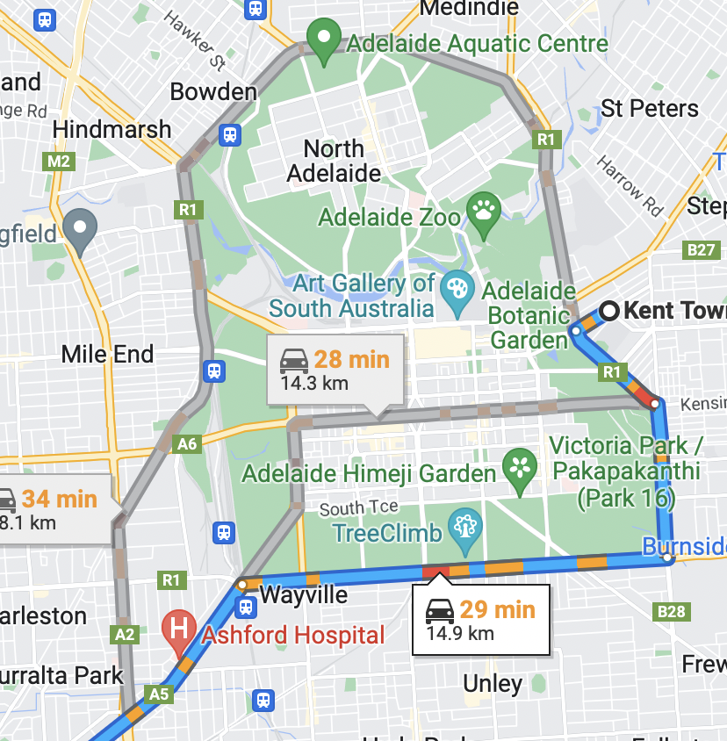

Slide 9
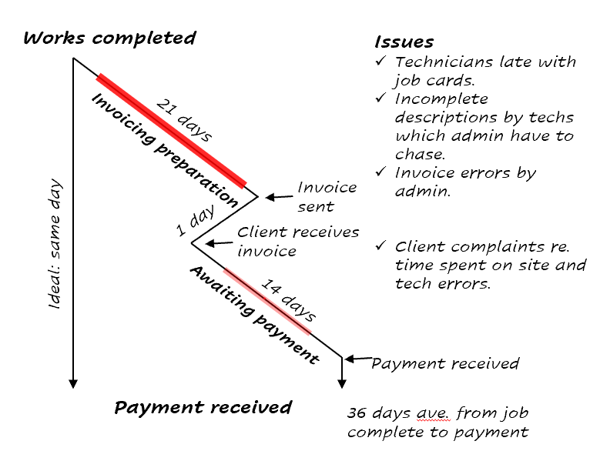

Slide 10
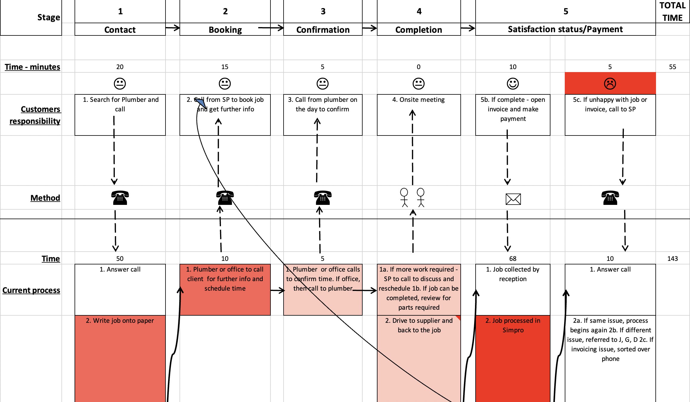

Slide 11
Current Timesheet Situation: 50 technicians with 4 managers
Onsite Technicians complete a manual timesheet each day
Take a photo or scan from phone
Send to manager
Manager checks, makes amendments as required, assigns job numbers, and emails to administration.
Admin. enters into Job Management Software with times being assigned to the various jobs
Report auto generated from head office and sent to head manager
Managers re-check for accuracy and make amendments as necessary
Above process takes 5 days

Slide 12
ONE WAY
Onsite electronic timesheets completed daily (job numbers are auto-assigned within software).
Algorithms established for checking common errors with auto generated report sent daily to managers.
Managers check and make necessary adjustments.
Process is overnight instead of 5 days.
BENEFITS
Accurate data capture from the field and is completed more efficiently – removes paper and potential misplacement thereof.
Algorithms do some of the work rather than people doing all the work.
4 day saving thus increasing cashflow and accuracy.
Admin overhead lowered.
More time made available for managers.

Slide 13
Customer calls to book onsite service call
Receptionist writes enquiry on a note
Note is hand delivered to technician’s daily tray
Tech reviews notes at day’s end
Tech calls customer the following day and schedules time
Note is updated by tech and hand delivered to admin tray
Admin updates the electronic schedule

Slide 14
Customer calls to book an onsite service call
Receptionist books time with customer and updates techs schedule

Slide 16
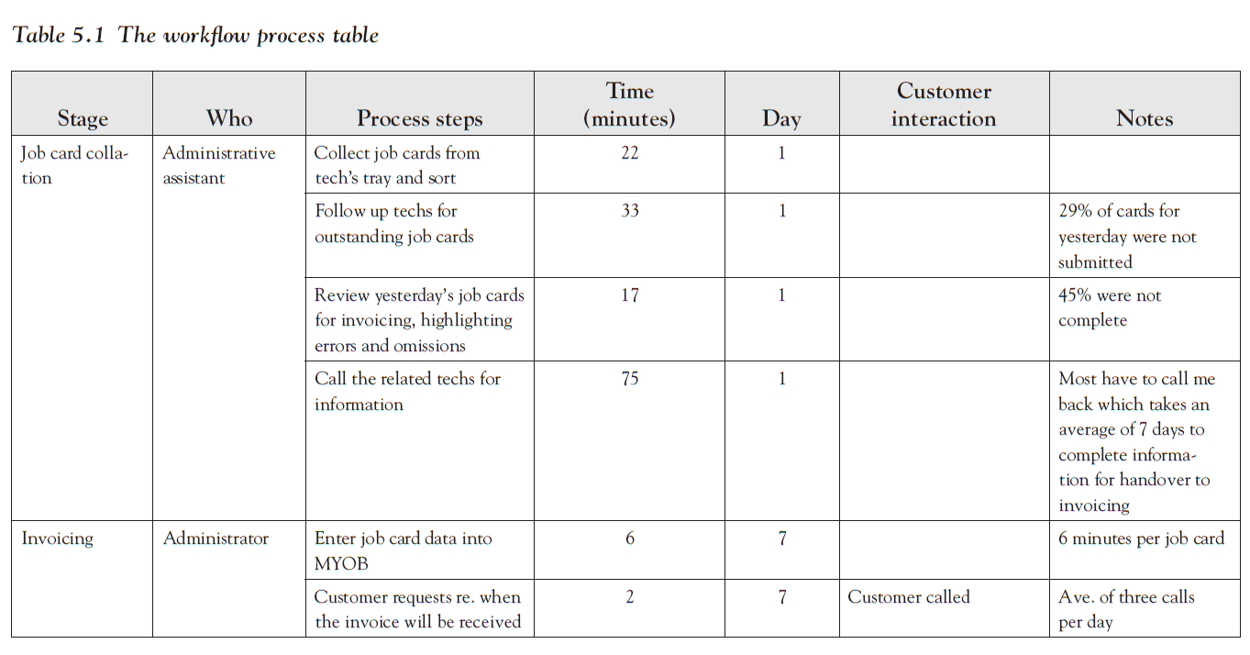

Slide 18
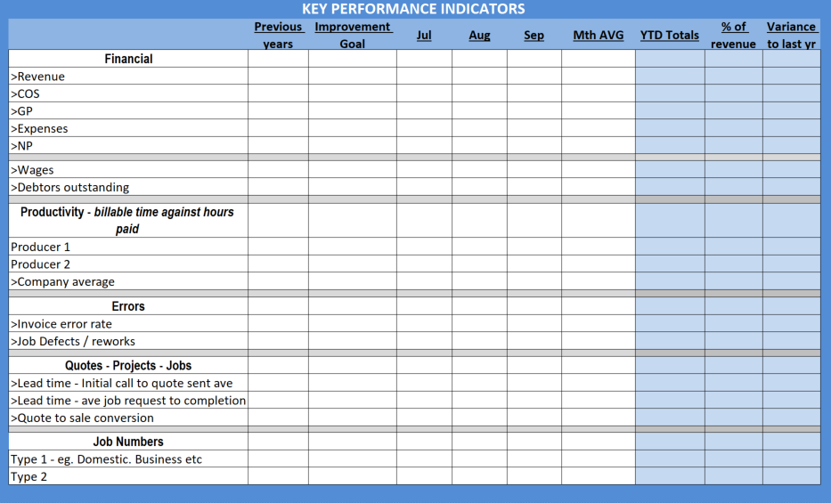

Slide 19
VERIFIED RESULTS FOR ONE COMPANY
Major process bottlenecks removed
Defined job roles in conjunction with the redesigned process map
All staff know EXACTLY what their responsibilities are with procedures and flow charts to follow
An estimated saving of 83 minutes per job which equated to 51 hours per week of additional time available by current employees
Profitability increase was 134% against last year’s average
Labour expenses reduced by 9%
Cost of sales reduced by 6%
Job cards waiting to be invoiced reduced by 29%
17% decrease in aged receivables
55% decrease in cost of defects
7% increase in average dollar sale

Slide 20
RESULTS FROM OTHER WORKFLOW/PROCESS IMPROVEMENT PROJECTS
Invoice turnaround from 90 days average to 5 days (job complete to invoice sent)
Administration time for one role reduced from 5 days per week to 2 days
821 increased billable hours made available through streamlining ordering process
2 days per month of administration time made available
Quote times reduced by 50%
238% nett profit increase in seven months through increased job flow
216% productivity increase in billable hours
47% revenue increase (the year after) from the firm’s continual application of the efficiency model implemented throughout the consulting project
65% increase in work over 4-months: reducing workflow bottlenecks combined with a marketing strategy

Slide 21
THE RAY HODGE EFFICIENCY IMPROVEMENT MODEL
1. Select Improvement Area
2. Map Relevant Processes
3. Identify Waste
4. Create Change Strategy
5. Gather historical data to use as a baseline measurement
6. Implement changes
7. Measure results against the baseline
8. Manage changes and adjust as required
9. Rinse and repeat

Slide 22
TIME MANAGEMENT

Slide 23
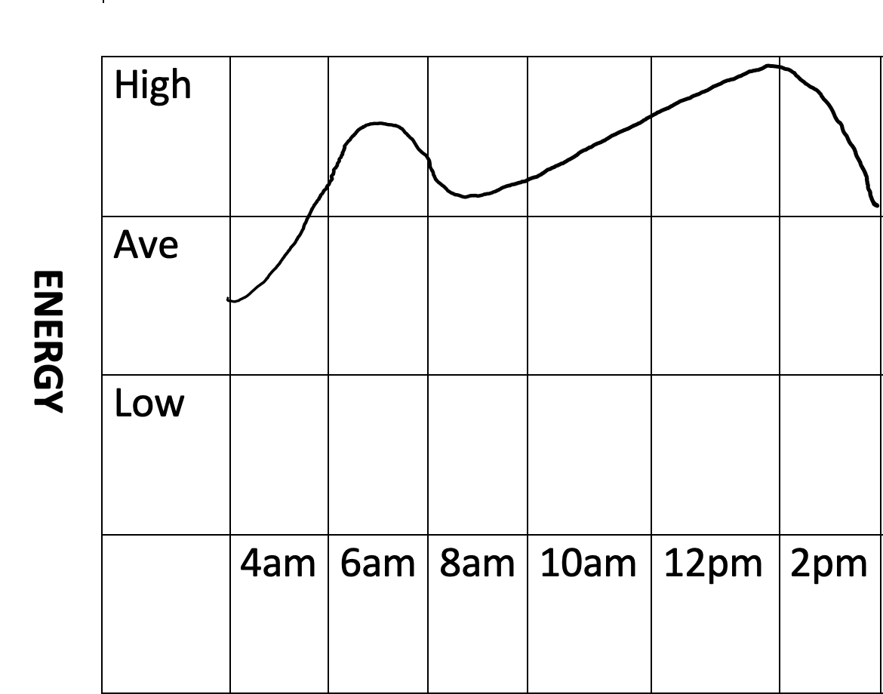

Slide 24
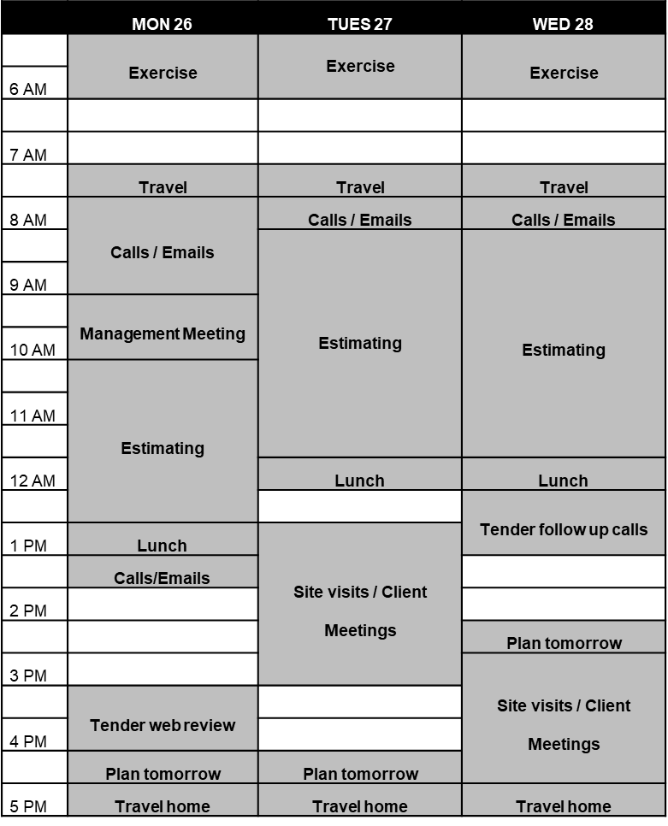

Slide 25
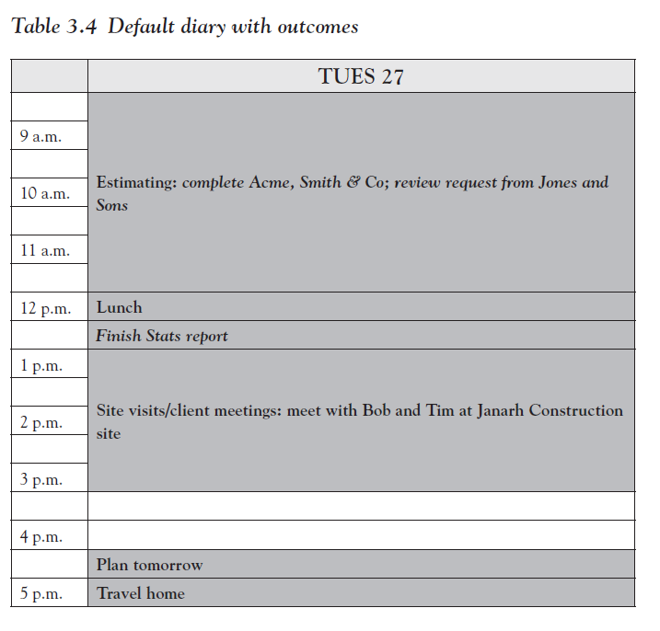

Slide 27
Call James Gowrie
Write report for ACME.
Arrange meeting with Sarah and Gary.
Submit tender to Northern Star.
Follow up CRM progress with Jane.
Review last month's financials.

Slide 28
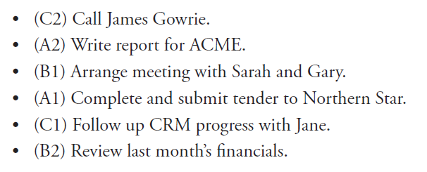

Slide 29
Fig 3.3 The All Roads Syndrome
Some roads All roads

Slide 30
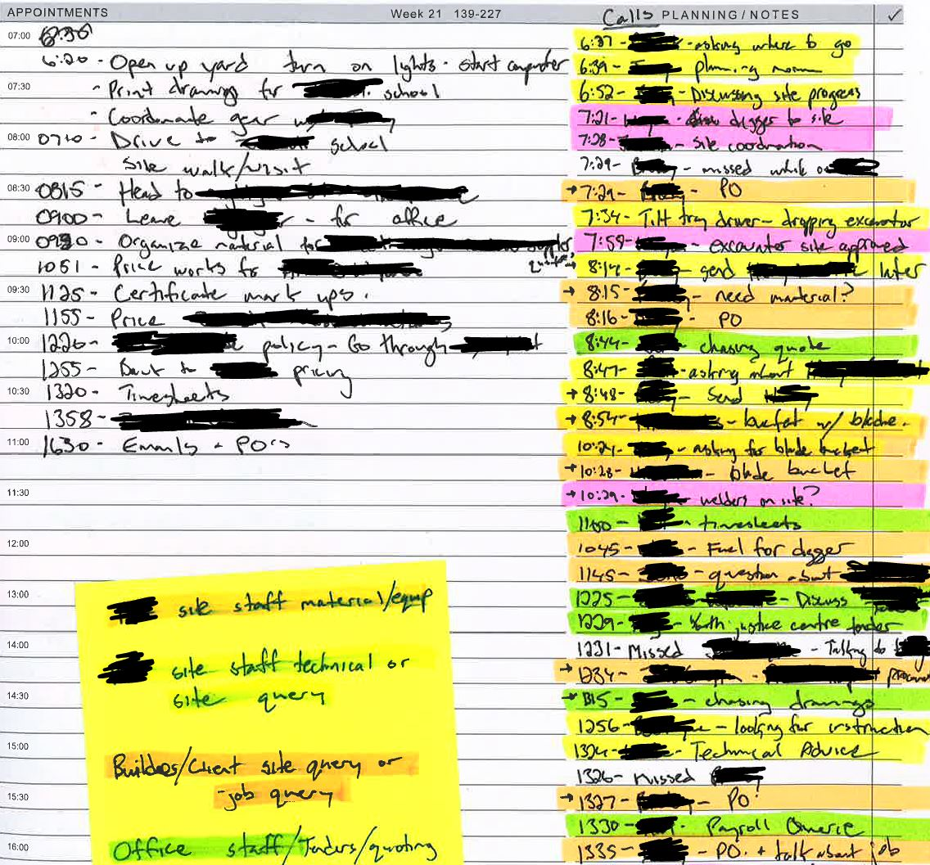
Time Analysis Example

Slide 31
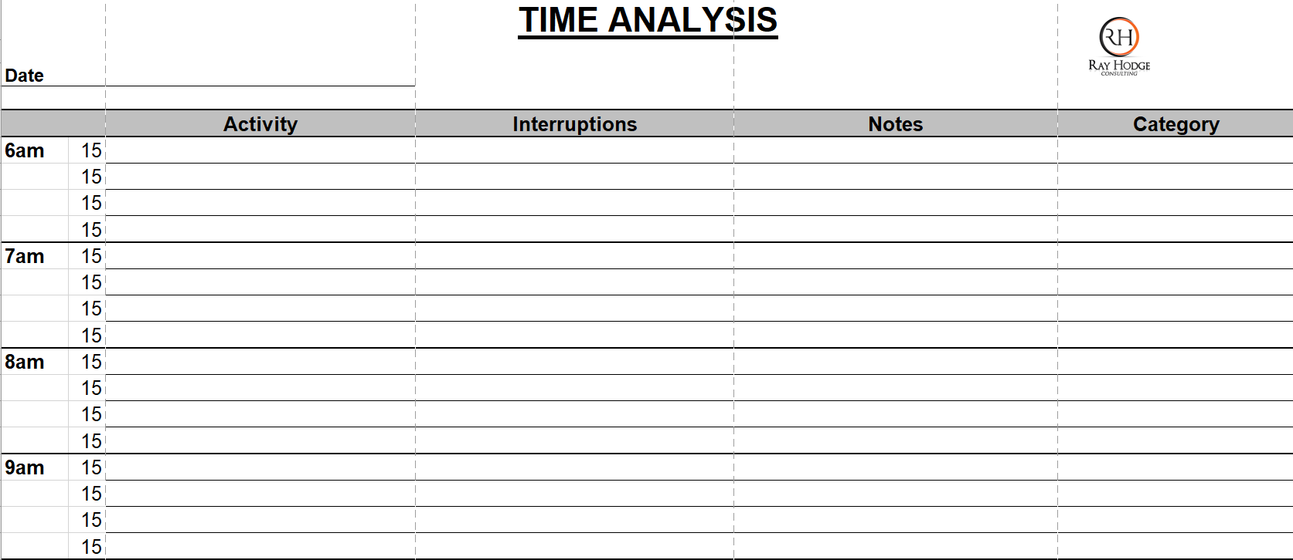

Slide 32
People

Slide 33
“We are concerned, then, with the causes of human behavior. We want to know why men behave as they do. Any condition or event which can be shown to have an effect upon behavior must be taken into account. By discovering and analyzing these causes we can predict behavior; to the extent that we can manipulate them, we can control behavior.”

Slide 34
“The most important feature of the laboratory method is the deliberate manipulation of variables: the importance of a given condition is determined by changing it in a controlled fashion and observing the result.”

Slide 35
Cause
Independent variables
Effect
Dependent variables
Personal Domain
Interfering State
Turn up to work
Meet KPI’s
Work Domain

Slide 36
Change Outcomes (what does it look like?) DEPENDENT VARIABLES | New conditions required INDEPENDENT VARIABLES | Available alternate behaviors INDEPENDENT VARIABLES | ReinforcementRequired | Costs | Benefits
Reduction in “where are you calls” | Finish at 4pm and midday Friday | Work on phone fear strategies | Intermittent praise | 6 – hours less p.w | Less tired More focus Decreased stress
 | Supportive leadership environment | Block time for the hard calls | List all pro-active calls then where r u

Slide 37
Social Styles
Emotionally Controlled
Non - directive
0
10
Directive
Assertiveness
Responsiveness
Notes:
Behavior not personality
Not right or wrong/good or bad
Assertiveness = seen by others as being forceful or directive.
Responsiveness = emotionally responsive or expressive
How would you recognize responsiveness? Assertiveness?
Questions
– if you are an employee sitting at 10 on responsiveness and your boss is at 0 ??
- if you are the boss sitting at 10 on directiveness and your employee is at 0??

Slide 38
Social Styles
Emotionally Controlled
Non - directive
0
10
Directive
Assertiveness
Responsiveness

Slide 39
Task
Emotionally Controlled
Analytical
Driver
Moderate
Non - directive
Directive
Fast
0
10
Assertiveness
Amiable
Expressive
Responsiveness
Emotionally Expressive
People
Notes:
Tick what applies.
Candid = frank, straight up
Prudent = careful, cautious, frugal
Overlay disc
How does each style navigate:
change?
confrontation?
Networking events?
Holiday planning?

Slide 40
Task
Emotionally Controlled
Analytical
Logical
Thorough
Serious
Systematic
Prudent
Driver
Independent
Candid
Decisive
Pragmatic
Efficient
Moderate
Non - directive
Directive
Fast
0
10
Assertiveness
Amiable
Cooperative
Supportive
Diplomatic
Patient
Loyal
Expressive
Outgoing
Enthusiastic
Persuasive
Fun Loving
Spontaneous
Responsiveness
Emotionally Expressive
People
Notes:
Tick what applies.
Candid = frank, straight up
Prudent = careful, cautious, frugal
Overlay disc
How does each style navigate:
change?
confrontation?
Networking events?
Holiday planning?

Slide 41
Analytical | Driver | Amiable | Expressive
What is important? | What is important? | What is important? | What is important?
Avoid: | Avoid: | Avoid: | Avoid:

Slide 42
Competency / Teachability Model
High
Low
Competence
High
Teachability
Low

Slide 43
Expertise - Teachability Model
High
3.
Fast Mover
4.
Autonomous
Low
Expertise
High
1.
Poor Fit
Teachability
2.
Know it All
Low

Slide 44
DIFFERENT EQUALS DIFFERENT
Life Areas | Gary – VP | Peter – GM
Values | Career and Money | Family
Skills | Organisation | Organisation
Gifts and Talents | Finance | Strategy
Wisdom | Makes sense of conflicting views | Understands people intuitively
History | No loss in his life | Loss of a previous wife to cancer and child to suicide
Behaviours | Dominant | Stable/Steady
Personality | Extrovert | Introvert
Self-Image | High | Low
Beliefs | Everyone should work as hard and as long as him | Results not time is what counts
Goals | Get to the top no matter how | Being a loving provider for his family
Motivations | Expansive public perception | The personal well being and engagement of his team
Interests and Passions | Work | Coaching his son’s soccer team
Notes:
How would Gary bring the best out in Peter?
Who would be best to help a worker going through a tough time?
How should Peter prepare for his weekly meeting with Gary?
How should Gary prepare?

Slide 45
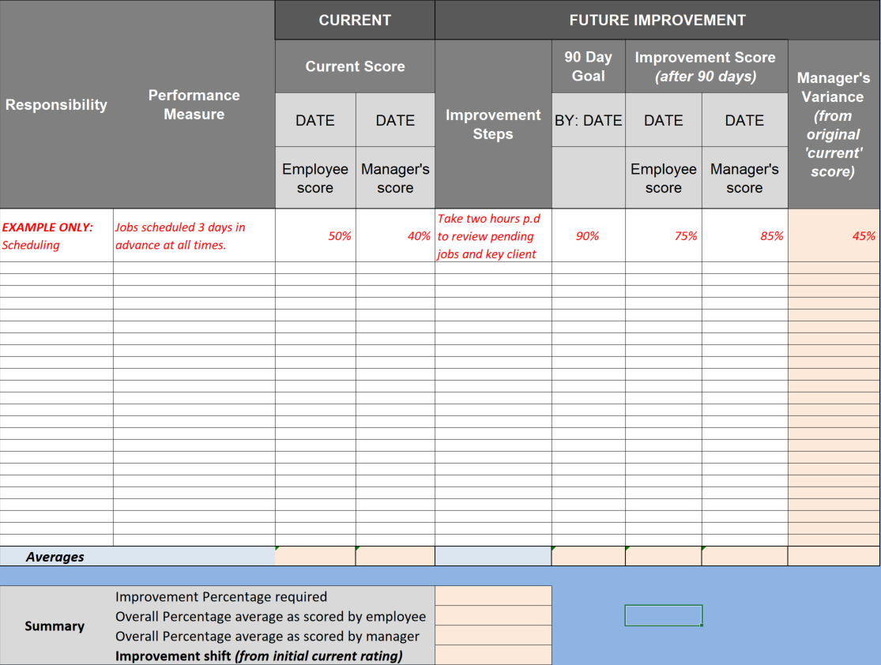

Slide 46
Step | Who | Process Steps | Time taken (min) | Day | Improvement Notes
Initial Call | R | Take call using script |  | 1
 |  | Enter details into CRM
 |  | Book appointment time | 12
Booking | S | Review schedules every afternoon

